Slide 1
HIS 103: Emergence of Bangladesh
The Language Movement 1952:
Background, Major Events and Political Significance
March 8, 2022

Slide 2
The Language Movement and the Growth of Bengalee Nationalism
The question as to what would be the state language of Pakistan was raised immediately after its creation.
Muslim League before the independence of Pakistan announced in Hydrabad, India that Urdu will be the only state language of the future state of Pakistan!
The central leaders and the Urdu-speaking intellectuals of Pakistan declared that Urdu would be the state language of Pakistan, just as Hindi was the state language of India.
The students and intellectuals of East Pakistan (notably Dr. Mohammad Shahidullah), however, demanded that Bengali be made one of the state languages.
After a lot of controversy over the language issue, the final demand from East Pakistan was that Bangla must be the official language and the medium of instruction in East Pakistan and for the central government it would be one of the state languages along with Urdu.

Slide 3
Outline of the Language Movement
The first movement on this issue was mobilized by Tamaddun Majlish (September 1, 1947) headed by Professor Abul Kashem (a physicist). Gradually many other non-communal and progressive organizations joined the movement, which finally turned into a mass movement (September 15, 1947: Tamaddun Majlish’s pumplet entitled “Pakistaner Rashtrabhasa Bangla na Urdu?)
Meanwhile, serious preparation was being taken in various forums of the central government of Pakistan under the initiative of Fazlur Rahman, the central education minister, to make Urdu the only state language of Pakistan.
On receipt of this information, East Pakistani students became agitated and held a meeting on the Dhaka University campus on 6 December 1947, demanding that Bangla be made one of the state languages of Pakistan.
The meeting was followed by student processions and more agitation. The first Rastrabhasa Sangram Parishad was formed towards the end of December, 1947 with Professor Nurul Huq Bhuiyan (Chemistry) of Tamaddun Majlish as the convener.
From 23 February 1948, the Constituent Assembly of Pakistan was in a session at Karachi-then the capital of Pakistan. It proposed that the members would have to speak either in Urdu or in English at the Assembly.

Slide 4
Outline of the Language Movement
Dhirendranath Dutta a member from the East Pakistan Congress Party, moved an amendment motion to include Bangla as one of the languages of the Constituent Assembly noting that out of the 6 crore 90 lakh population of Pakistan, 4 crore 40 lakh were from East Pakistan with Bangla as their mother tongue.
The central leaders, including, Liaquat Ali Khan, prime minister of Pakistan, and Khwaja Nazimuddin, Chief Minister of East Pakistan, opposed the motion.
On receiving the news that the motion had been rejected, students, intellectuals and politicians of East Pakistan became agitated.
Newspapers such as the Azad also criticized the politicians who had rejected the motion. A new committee to fight for Bangla as the state language was formed with Shamsul Huq as convener.
On 11 March 1948 a general strike was observed in the towns of East Pakistan in protest against the omission of Bangla from the languages of the Constituent Assembly, the absence of Bangla letters in Pakistani coins and stamps, and the use of only Urdu in recruitment tests for the navy.

Slide 5
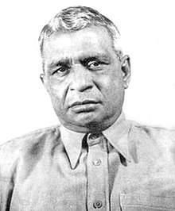
Dhirendranath Dutta

Slide 6
Outline of the Language Movement
The movement also reiterated the earlier demand that Bangla be declared one of the state languages of Pakistan and the official language of East Pakistan.
Amidst processions, picketing and slogans, leaders such as Shawkat Ali, Kazi Golam Mahboob, Shamsul Huq, Oli Ahad, Sheikh Mujibur Rahman, Abdul Wahed and others were arrested. Student leaders, including Abdul Matin and Abdul Malek Ukil, also took part in the procession and picketing.
Under such circumstances the government had to negotiate with the students. Khwaja Nazimuddin signed an agreement with the student leaders. However, although he agreed to a few terms and conditions, he did not comply with their demand that Bangla be made a state language.
M. A. Jinnah, the governor general of Pakistan, came to visit East Pakistan on 19 March, 1948. He addressed two meetings in Dhaka (March 21, 1948 at Ramna Racecourse) in both of which he ignored the popular demand for Bangla. He repeated that Urdu would be the only state language of Pakistan.

Slide 7
Major Events: Reaction to the Speech of Jinnah
This declaration of Jinnah was instantly protested with the Language Movement spreading throughout East Pakistan. The movement continued under the leadership of different organization.
The creation of Awami Muslim League in 1949 gave the movement a more organized political form.
The Dhaka University Language Action Committee was formed on 11 March 1950 with Abdul Matin as its convener (popularly known as Bhasa Matin).
By the beginning of 1952, the Language Movement took a serious turn. Both Jinnah and Liaquat Ali Khan died on 11 September 1948 and on 16 October 1951 respectively.
Khwaja Nazimuddin had succeeded Liaquat Ali Khan and became the prime minister of Pakistan.
In addition to this, there was a growing sense of deprivation and exploitation in East Pakistan and a realization that a new form of colonialism had replaced British imperialism.
Under these circumstances, the Language Movement got a new momentum in 1952. On 27 January 1952, Khwaja Nazimuddin came to Dhaka from Karachi.

Slide 8
Major Events: Reaction to the Speech of Jinnah
Addressing a meeting at Paltan Maidan, Khawja Nazimuddin said that the people of the province could decide what would be the provincial language, but only Urdu would be the state language of Pakistan.
There was a sudden, negative reaction to this speech among the students who responded with the slogan, 'Rashtrabhasha Bangla Chai‘
A strike was observed at Dhaka University on 30 January, 1952.
The representatives of various political and cultural organizations held a meeting on 31 January chaired by Moulana Bhasani.
An All-Party Central Language Action Committee was formed on January 31, 1952 with Kazi Golam Mahboob as its convener.
At this time the government also proposed that Bangla be written in Arabic script! (Islamization of Bengali)
This proposal was also vehemently opposed. The Language Action Committee decided to call a hartal and organize demonstrations and processions on February 21 throughout East Pakistan.

Slide 9
Major Events: Demonstration against the government
Bangabandhu’s “hunger strike” in jail from February 16, 1952 demanding Bangla as state language provided further impetus to the movement.
As preparations for demonstrations were underway, the government imposed Section 144 in Dhaka city banning all assemblies and demonstrations.
A meeting of the Central Language Action Committee was held on 20 February under the chairmanship of Abul Hashim where the opinion was divided as to whether or not to violate Section 144.
The students were determined to violate Section 144 and held a student meeting at 11.00 am on 21 February on the Dhaka University campus, then located close to the Medical College Hospital. When the meeting started, the Vice-Chancellor, along with a few university teachers, came to the spot and requested the students not to violate the ban on assembly.
The students, under their leaders - Abdul Matin and Gaziul Haque - were adamant. Thousands of students from different schools and colleges of Dhaka assembled on the university campus while armed police waited outside the gate.

Slide 10
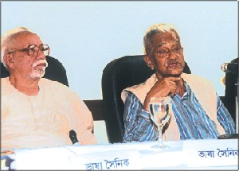
Demonstration…

Slide 11
Government Actions
Firing on the students and its aftermath:
Unable to control the agitated students, the police fired upon the crowd of students, who were proceeding towards the Assembly Hall (at present, part of Jagannath Hall, University of Dhaka).
Three young men, Rafiq Uddin Ahmed, Abdul Jabbar and Abul Barkat (an MA student of Political Science) were fatally wounded. Many injured persons were admitted to the hospital.
Among them Abdus Salam, a peon at the Secretariat, subsequently surrendered to his wounds. A nine-year-old boy named Ohiullah was also killed.
At the Legislative Assembly building, the session was about to begin. On heard the news of the shooting, some members of the Assembly, including Maulana Abdur Rashid Tarkabagish and some opposition members, went out and joined the students. In the Assembly, Nurul Amin, chief minister of East Pakistan, continued to oppose the demand for Bangla.

Slide 12

Aftermath o f the Government Action
Aftermath:
The next day, 22 February, was also a day of public demonstrations and police reprisals.
The public performed a Janaza (“Gayebana Janaza” held for Ekushey martyrs) and brought out a mourning procession.
On 23 February night, at the spot where students had been killed, a memorial was erected. Three days later, the police demolished the memorial.
Nevertheless, the movement for the recognition of Bangla as a state language gained momentum. After the resounding victory of the united front in 1954, Bangla was recognized as one of the state languages of Pakistan at a session of the National Assembly on 9 May 1954.
In 1963, the temporary structure was replaced by a concrete memorial, the Shaheed minar.

Slide 13
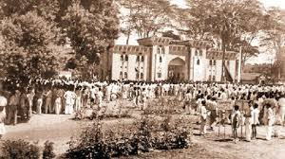
Language Movement in Pictures

Slide 14
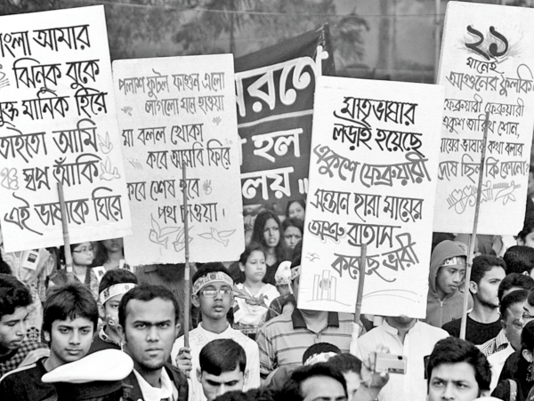
Language Movement in Pictures

Slide 15
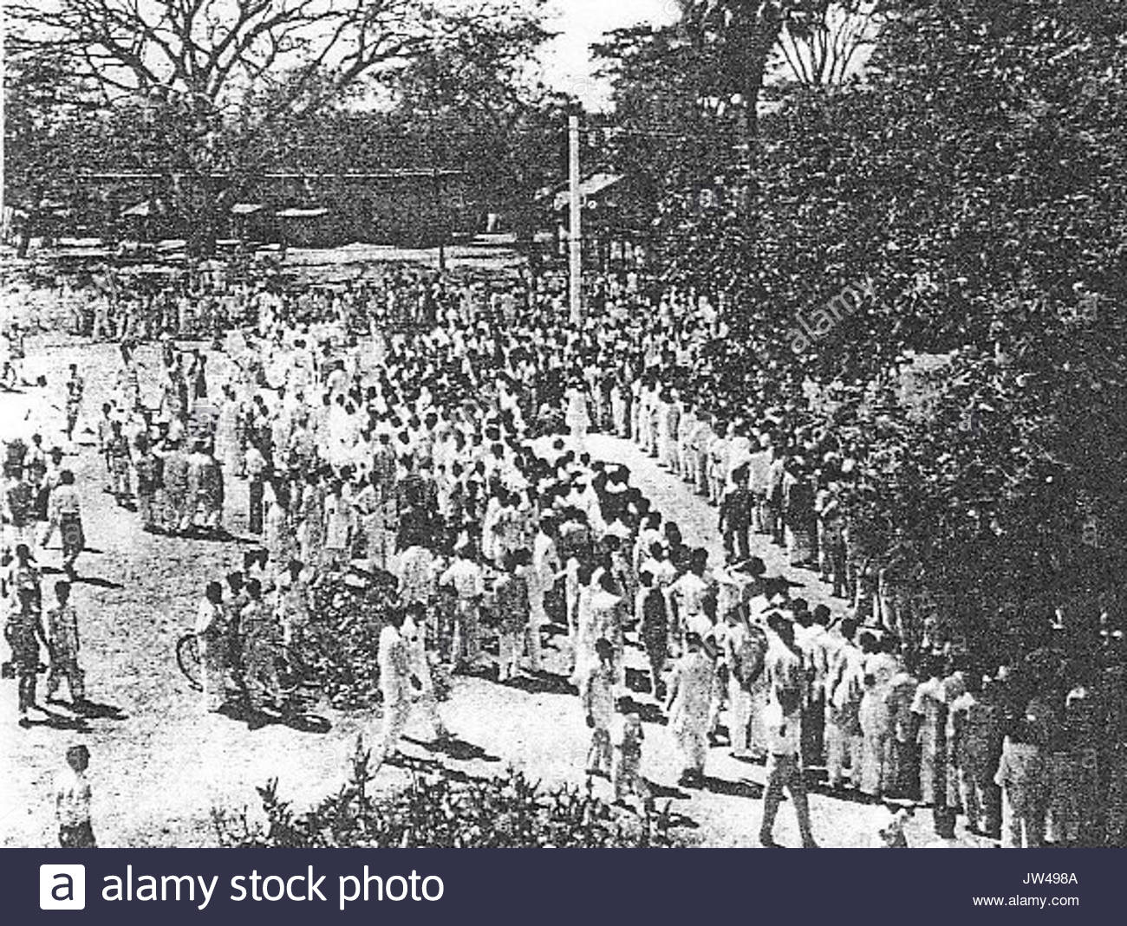
Language Movement in Pictures

Slide 16
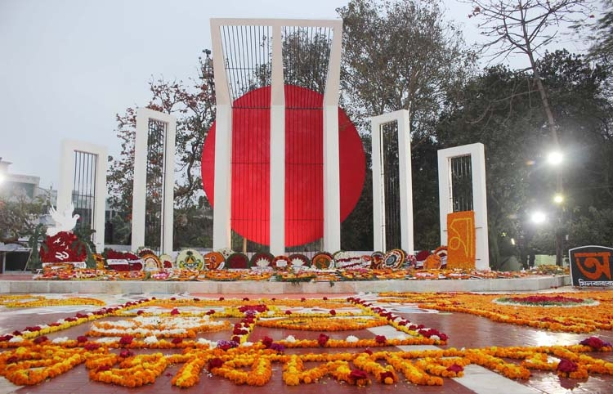
Language Movement in Pictures

Slide 17
The Language Movement
Harvests of the Movement:
Decision to commemorate 21 February as Shaheed Dibosh by the Shorbodolio Kendrio Rahstrobhasha Sangram Parishod.
The language movement continued until 1956. The movement achieved its goal by forcing the Pakistan Constituent Assembly in adopting both Bangla and Urdu as the state languages of Pakistan.
While the Assembly was debating on the language issue, Member Adel Uddin Ahmed (1913-1981; Faridpur) made an important amendment proposal, which was adopted unanimously by the Assembly (16 February 1956).
Both Bangla and Urdu were thus enacted to be the national languages of Pakistan.
This movement laid a major foundation of our liberation war.
17 November, 1999, the UNESCO General Convenience recognized 21 February as International Mother Language Day.
Since 2000, 21 February is also being observed as the International Mother Language Day.

Slide 18
The Language Movement
Significance of the Language Movement:
The language movement was an unprecedented fact not only in our national history, but also in human history. The movement was not isolated to this as it sowed the seeds for the independence movement of the Bangladesh
This movement created a strong sense of nationalism which had its impact on subsequent political developments leading to the War of Independence in 1971.
Ekushey February plays an important role to help Bengalis to be aware of their cultural and national heritage and ultimately towards the to the rise of Bengali nationalism.
The language movement infused unity and solidarity among the Bengali people, and encouraged them to be united against exploitation, deprivation and autocratic decision of then Pakistani rulers.

Slide 19
The Language Movement
Significance (contd…):
Language movement was an eye-opener for the Bengali people about their fundamental rights- political, economic and social rights. In fact, it helped Bengalese to be conscious about their rights.
Through the language movement, the Bengali people created one of the greatest political and cultural histories in the 20th century- a history written by blood. The events of 21st February 1952 proved that a nation which is strong and powerful politically cannot destroy a spirited civilized nation if they have a unifying language like Bangla.
As a source of ceaseless inspiration, 21st February inspired the people of Bangladesh to a great extent to achieve the right to self-determination and sovereign state.
The language movement helped to develop a non-communal sense among the Bengalese cementing Hindu-Muslim unity.

Slide 20
The Language Movement
From Language Movement to the War of Liberation:
On 7 May 1954, the constituent assembly resolved, with the Muslim League's support, to grant official status to Bengali. Bengali was recognized as the second official language of Pakistan on 29 February 1956, and article 214(1) of the constitution of Pakistan was reworded to "The state language of Pakistan shall be Urdu and Bengali.“
Impact on the student movement of 1962, on six-point Programme in 1966 and the Mass uprising in 1969.
In line with the spirit of Language Movement, Bangladesh achieved its long cherished freedom through a nine month long armed struggle under the charismatic leadership of Father of the Nation Bangabandhu Sheikh Mujibur Rahman.
Movie (Fagun Hawai) Link: https://youtu.be/NmXPAeaRzmc

